Slide 1
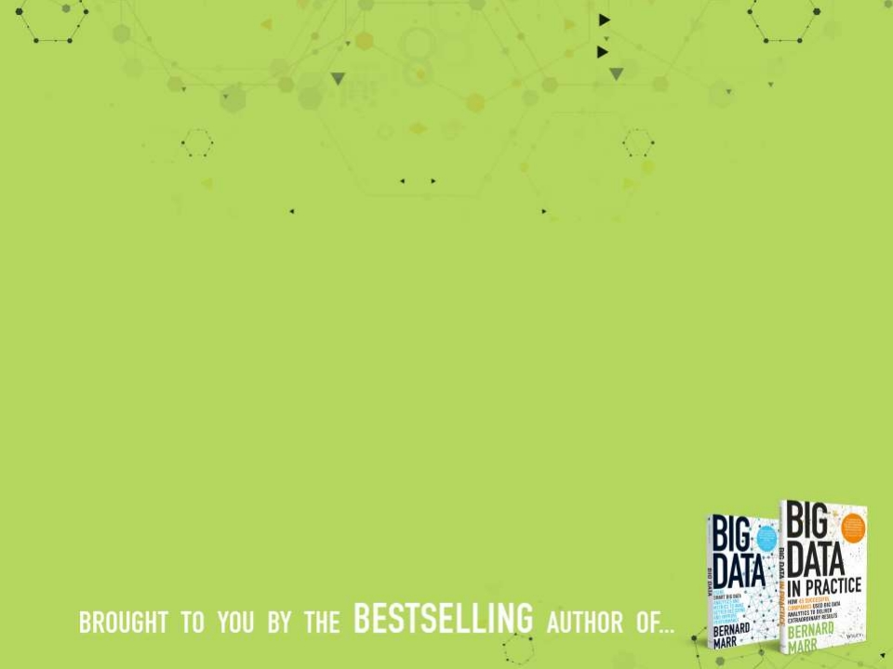
Big Data
What is it?

Slide 2
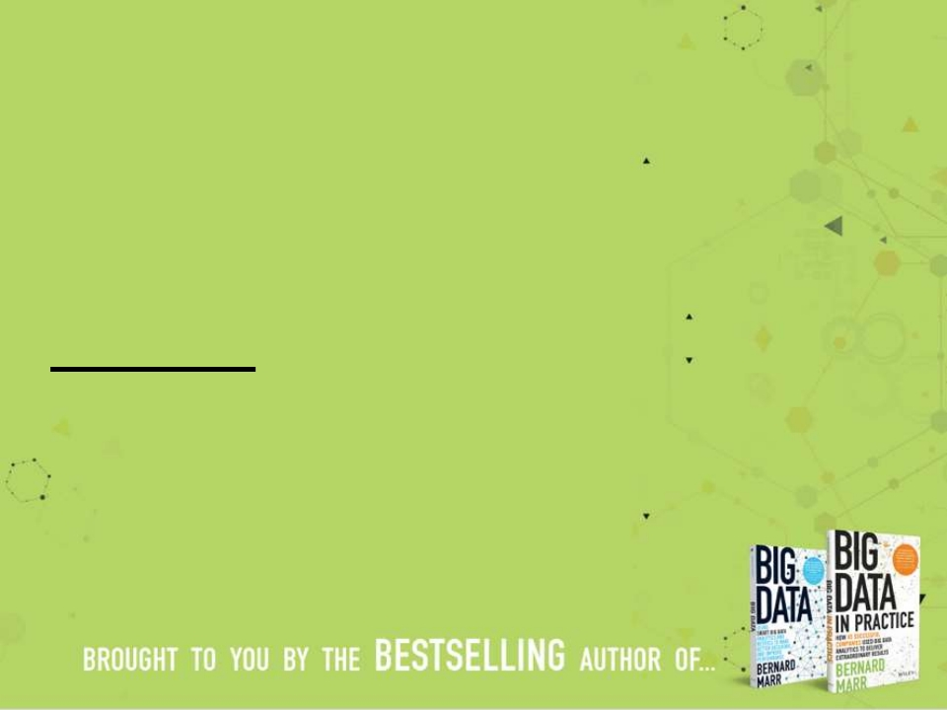
There are some things that are so
big that they have implications for
everyone, whether we want it or
not.
Big Data is one of those things,
and is completely transforming the
way we do business and is
impacting most other parts of our
lives.

Slide 3
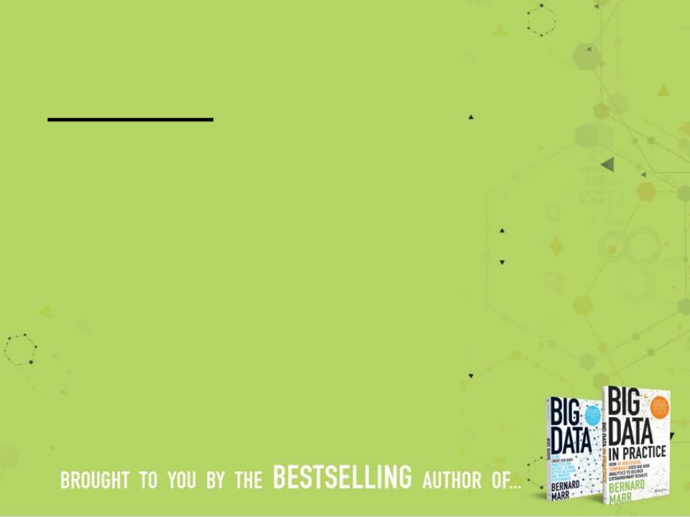
The basic idea behind the phrase
'Big Data' is that everything we do
is increasingly leaving a digital
trace (or data), which we (and
others) can use and analyse.
Big Data therefore refers to our
ability to make use of the ever-
increasing volumes of data.

Slide 4
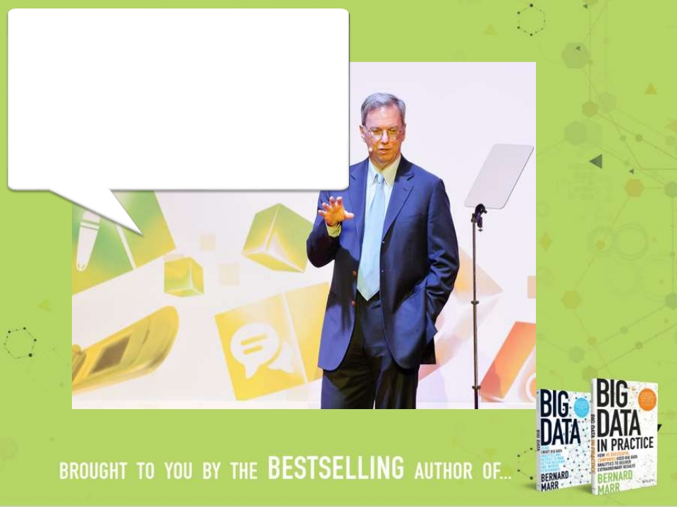
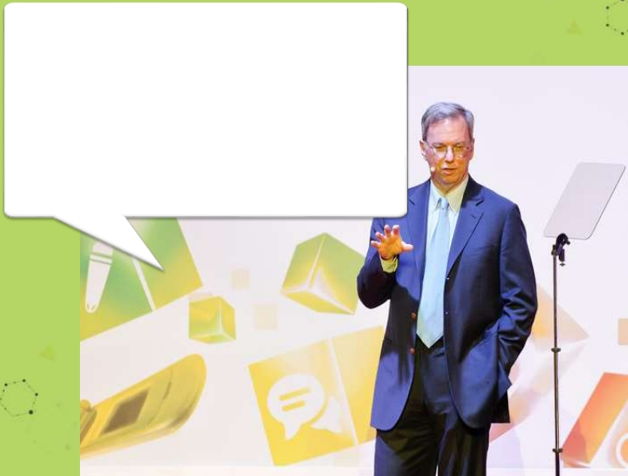
From the dawn of civilization until
2003, humankind generated five
exabytes of data. Now we produce
five exabytes every two days…and
the pace is accelerating.
Eric Schmidt,
Executive Chairman, Google

Slide 5
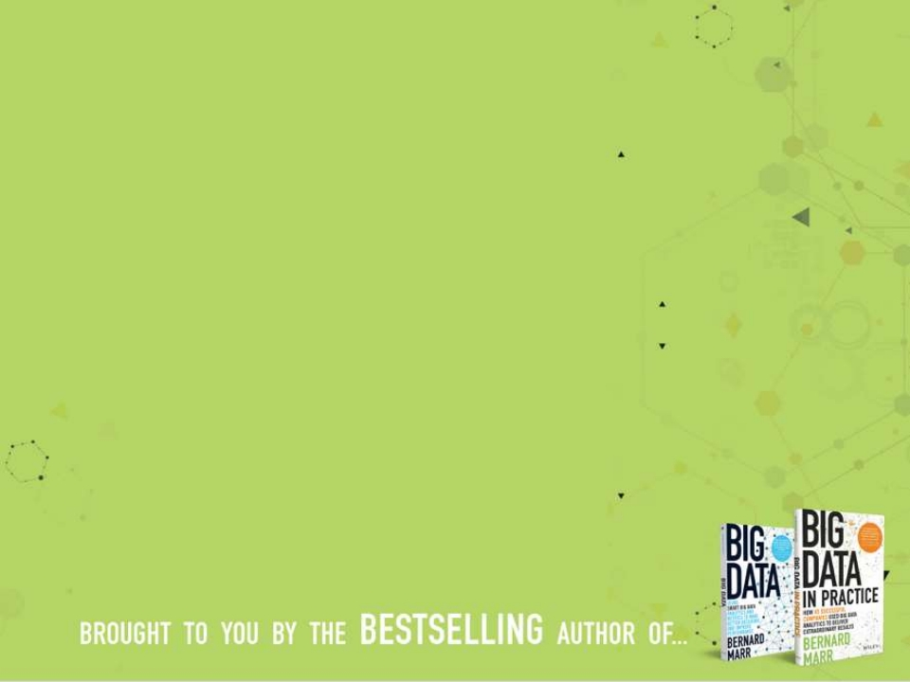
Activity Data
Simple activities like listening to music or
reading a book are now generating data.
Digital music players and eBooks collect data
on our activities. Your smart phone collects
data on how you use it and your web browser
collects information on what you are
searching for. Your credit card company
collects data on where you shop and your
shop collects data on what you buy. It is hard
to imagine any activity that does not
generate data.

Slide 6
Conversation Data
Our conversations are now digitally
recorded. It all started with emails but
nowadays most of our conversations
leave a digital trail. Just think of all the
conversations we have on social media
sites like Facebook or Twitter. Even many
of our phone conversations are now
digitally recorded.

Slide 7
Photo and Video Image
Data
Just think about all the pictures we take on
our smart phones or digital cameras. We
upload and share 100s of thousands of
them on social media sites every second.
The increasing amounts of CCTV cameras
take video images and we up-load
hundreds of hours of video images to
YouTube and other sites every minute .

Slide 8
Sensor Data
We are increasingly surrounded by sensors
that collect and share data. Take your smart
phone, it contains a global positioning
sensor to track exactly where you are every
second of the day, it includes an
accelometer to track the speed and
direction at which you are travelling. We
now have sensors in many devices and
products.

Slide 9
The Internet of Things
Data
We now have smart TVs that are able to collect
and process data, we have smart watches,
smart fridges, and smart alarms. The Internet
of Things, or Internet of Everything connects
these devices so that e.g. the traffic sensors on
the road send data to your alarm clock which
will wake you up earlier than planned because
the blocked road means you have to leave
earlier to make your 9am meeting…
.

Slide 10
With the datafication comes
big data, which is often
described using the four Vs
:
• Volume
• Velocity
• Variety
• Veracity

Slide 11
Volume…
…refers to the vast amounts of data generated
every second. We are not talking Terabytes but
Zettabytes or Brontobytes. If we take all the
data generated in the world between the beginning of time and 2000, the same amount
of data will soon be generated every minute.
New big data tools use distributed systems so
that we can store and analyse data across databases that are dotted around anywhere in
the world.

Slide 12
Velocity…
…refers to the speed at which new data is
generated and the speed at which data moves around. Just think of social media messages going viral in seconds. Technology allows us now to analyse the data while it is being generated (sometimes referred to as in-memory analytics), without ever putting it into databases.

Slide 13
Variety…
…refers to the different types of data we can now use.
In the past we only focused on structured data that neatly fitted into tables or relational databases, such as financial data.
In fact, 80% of the world’s data is unstructured (text, images, video, voice, etc.)
With big data technology we can now analyse and bring together data of different types such as messages, social media conversations, photos, sensor data, video or voice recordings.

Slide 14
Veracity…
…refers to the messiness or trustworthiness of
the data. With many forms of big data quality
and accuracy are less controllable (just think of
Twitter posts with hash tags, abbreviations,
typos and colloquial speech as well as the
reliability and accuracy of content) but
technology now allows us to work with this
type of data.

Slide 15
Turning Big Data into Value:
The datafication of our world gives us
unprecedented amounts of data in
terms of Volume, Velocity, Variety and
Veracity. The latest technology such as
cloud computing and distributed
systems together with the latest
software and analysis approaches allow
us to leverage all types of data to gain
insights and add value.

Slide 16
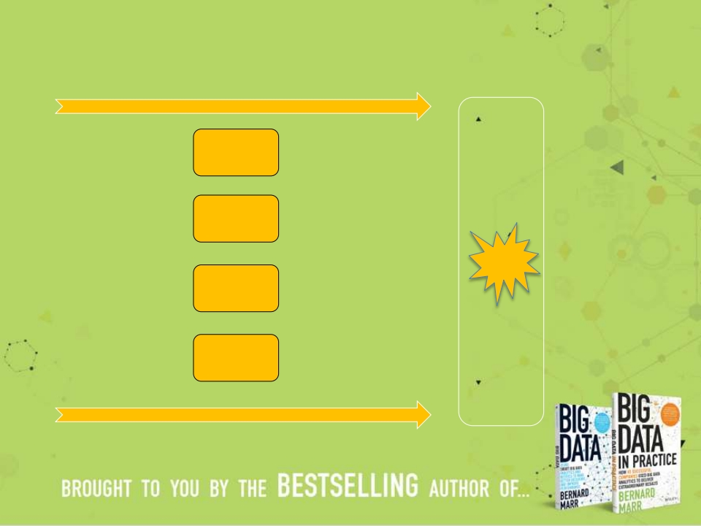

Turning Big Data into Value:
The ‘ Datafication ’
of our World;
Volume
Analysing
Big Data:
•
•
•
•
•
•
•
•
•
•
Activities
Conversations
Words
Voice
Social Media
Browser logs
Photos
Videos
Sensors
Etc.
•
•
•
•
•
•
Text
analytics
Sentiment
analysis
Face
recognition
Voice
analytics
Movement
analytics
Etc.
Velocity
Variety
Veracity
Value

Slide 17
How is Big Data actually used? Example 1
Better understand and target customers:
To better understand and target customers,
companies expand their traditional data sets with
social media data, browser, text analytics or sensor
data to get a more complete picture of their
customers. The big objective, in many cases, is to
create predictive models. Using big data, Telecom
companies can now better predict customer churn;
retailers can predict what products will sell, and car
insurance companies understand how well their
customers actually drive.

Slide 18
How is Big Data actually used? Example 2
Understand and Optimize Business
Processes:
Big data is also increasingly used to optimize
business processes. Retailers are able to optimize
their stock based on predictive models generated
from social media data, web search trends and
weather forecasts. Another example is supply chain
or delivery route optimization using data from
geographic positioning and radio frequency
identification sensors.

Slide 19
How is Big Data actually used? Example 3
Improving Health:
The computing power of big data analytics enables
us to find new cures and better understand and
predict disease patterns. We can use all the data
from smart watches and wearable devices to better
understand links between lifestyles and diseases.
Big data analytics also allow us to monitor and
predict epidemics and disease outbreaks, simply by
listening to what people are saying, i.e. “Feeling
rubbish today - in bed with a cold” or searching
for on the Internet, i.e. “cures for flu”.

Slide 20
How is Big Data actually used? Example 4
Improving Security and Law Enforcement:
Security services use big data analytics to foil
terrorist plots and detect cyber attacks. Police
forces use big data tools to catch criminals and
even predict criminal activity and credit card
companies use big data analytics it to detect
fraudulent transactions.

Slide 21
How is Big Data actually used? Example 5
Improving Sports Performance:
Most elite sports have now embraced big data
analytics. Many use video analytics to track the
performance of every player in a football or
baseball game, sensor technology is built into
sports equipment such as basket balls or golf clubs,
and many elite sports teams track athletes outside
of the sporting environment – using smart
technology to track nutrition and sleep, as well as
social media conversations to monitor emotional
wellbeing.

Slide 22
How is Big Data actually used? Example 6
Improving and Optimizing Cities and
Countries:
Big data is used to improve many aspects of our cities
and countries. For example, it allows cities to optimize
traffic flows based on real time traffic information as
well as social media and weather data. A number of
cities are currently using big data analytics with the aim
of turning themselves into Smart Cities, where the
transport infrastructure and utility processes are all
joined up. Where a bus would wait for a delayed train
and where traffic signals predict traffic volumes and
operate to minimize jams.

Slide 23
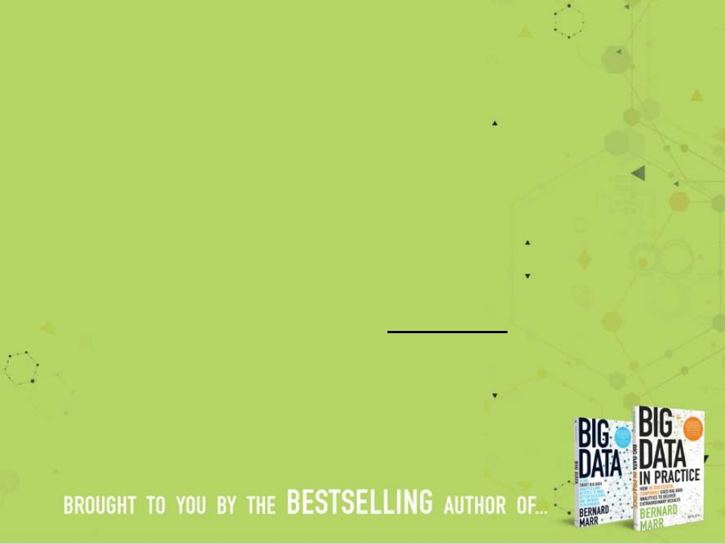
But the applications of Big
Data are endless!
Currently we are only seeing the beginnings of
a transformation into a big data economy.
Any business that doesn’t seriously consider
the implications of Big Data runs the risk of being
left behind.
.

Slide 24
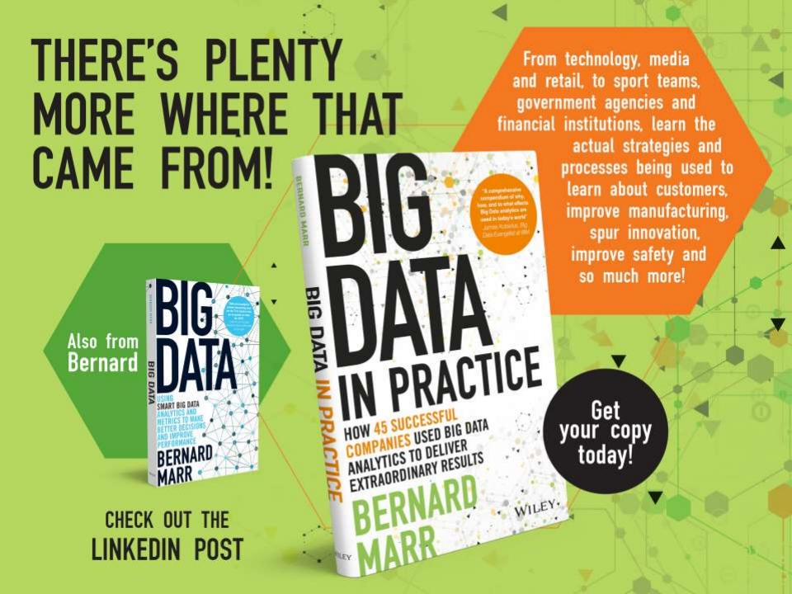

Slide 25
